Slide 1





E-COMMERCE SALES
ANALYSIS
MYSQL

Slide 2






TOTAL REVENUE

Slide 3
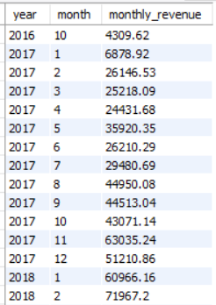
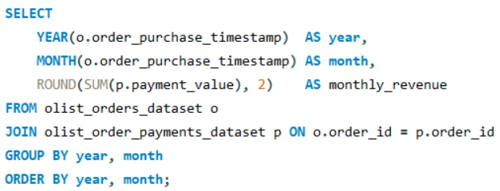
MONTHLY REVENUE TREND

Slide 4

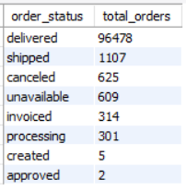
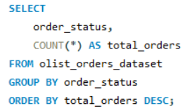

TOTAL ORDERS BY STATUS

Slide 5


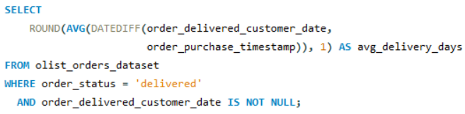

AVERAGE DELIVERY TIME (IN DAYS)

Slide 6
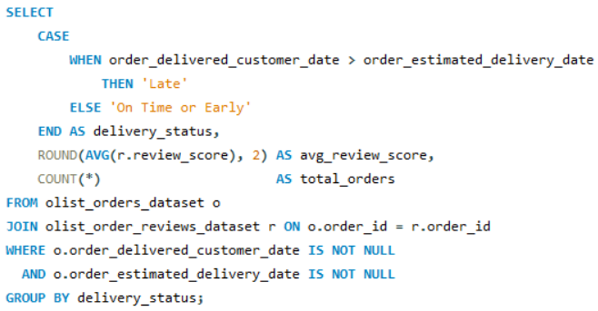

LATE VS ON-TIME DELIVERIES — IMPACT ON REVIEW SCORE

Slide 7
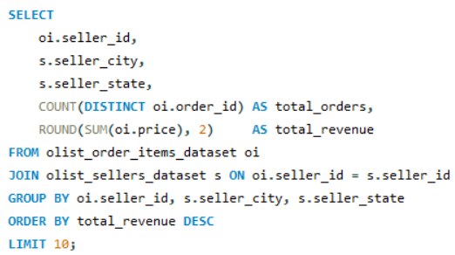
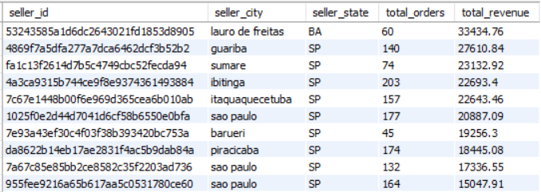
TOP 10 SELLERS BY REVENUE

Slide 8
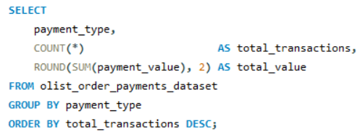
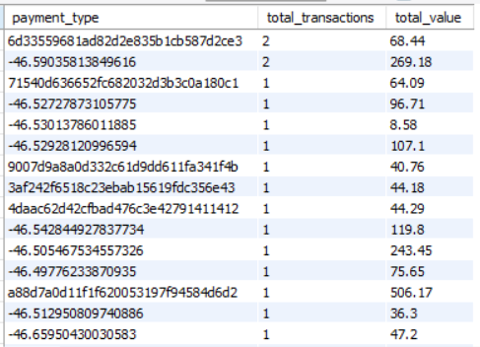
MOST POPULAR PAYMENT METHOD

Slide 9

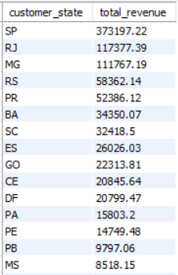
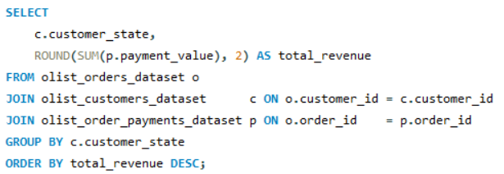
REVENUE BY STATE

Slide 10

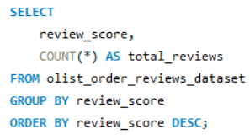
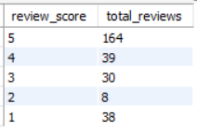
REVIEW SCORE DISTRIBUTION

Slide 11
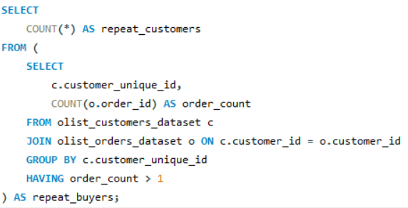

REPEAT CUSTOMERS

Slide 12
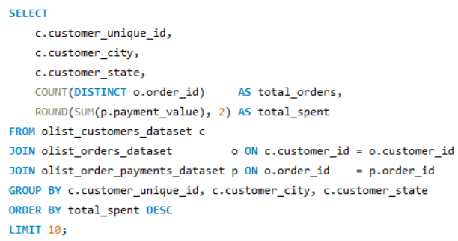
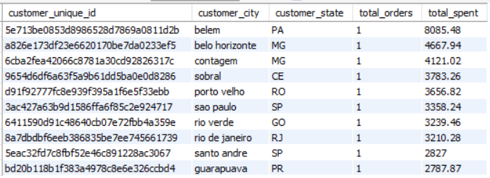
TOP 10 CUSTOMERS BY TOTAL SPENDING

Slide 13

THANK YOU

